Slide 1

SENTIMENT ANALYSIS
AIRLINES

Slide 2
Plan
01
Introduction
Introduction to Sentiment Analysis & types
04
Results & Interpretation
Aims and Objectives
Problem Statement
Data Analysis
Topic Modeling
Unsupervised Learning
02
Methodology
Data Analysis
Technologies and tools
Approaches adopted
05
Metrics
03
Discussion and Conclusion
Setup and Analysis procedures
Data Analysis
Topic Modeling
Unsupervised Learning
Supervised Learning

Slide 3
Timeline Adopted
Environment Initiation
Testing & Validation
XXXX
Creating conda environement with the appropriate python version , libraries and t their dependencies
XXXX
Testing model evaluation in order to confirm models efficiency.
Data gathering & Proposal
Development
Reporting
XXXX
Searching for data to practiace Sentiment Analysis techniques and create project proposal.
XXXX
Starts Data Analysis, Topic Modeling with LDA, NLP unsupervised model, Supervised ML model and finally supervised hybrid model
XXXX
Create a scientific report or research paper, as well as a pptx

Slide 4
Our Team Style
PAVAN ^^
Kishore ^^
Special credits and thanks to our supervisor XXXXX for being here for us, teaching us the best IT technologies treating real world issues, this project was based on the work & labs we’ve gone trough in the course.

Slide 5
Natural Language Processing
Topics Identification
Spam Classification
Identify relevant topic or topics requires the usage of NLP techniques as well.
Classify spam messages from good ones based on historical data usin ML, or on the message content using NLP
Chatbots
Grammar Autocorrector
Creating chatbots requires text mining and processing which needs NLP techniques
Directly use words and phrases as input,, so making a successful grammar autocorrector depends highly on all NLP techniques
NLP
You can simply impress your audience and add a unique zing and appeal to your Reports and Presentations with our Templates.
Sentiment Analysis
Resume Parsing System
Identifying the emotions behind the words or based on a data suitable for sentiment analysis, can be done using ML and DL etc …
Parsing Resume requires Data mining as well as text mining techniques, duce NLP is required too.

Slide 6
SENTIMENT
ANALYSIS
Sentiment Analysis or Opinion Mining is the interpretation and classification of emotions (positive, negative and neutral) in text data using text analysis techniques.
Sentiment Analysis allows companies to identify customer’s opinions about products, brands or services in online conversations and comments.

Slide 7
Sentiment Analysis types
System based on machine learning techniques
Supervised : RF, LR
Rule-based system
Unsupervised Learning using polarity concept
Hybrid system
Supervised : Based on both NLP + ML

Slide 8
AIMS
OBJECTIVES
Extracting insight from data by conducting descriptive and prescriptive analysis
Conducting Predictive Analysis by applying Sentiment Analysis and Machine Learning.
Conclude on the best model based on metrics results and provide Interpretation.

Slide 9
PROBLEM STATEMENT
Context
Companies nowadays are more focused on the relation with the client, recently it was prooved that a good relationship with the customer increase the client fidelity and create a unique idendity for the company, as well as for bringing new customers. To better handle this part a sentiment analysis approach is one of the most powerfull insights area we can access. For example creating a questionning formula with the right and good answer will give you a new Idea about the customer feeling and needs, this way you can improve decisions and change startegies based on the customer needs, even future needs or trends comming up and needing adaptation. For our case we have an airlines dataset containing reviews and rating columns as input and the recommended column wich is binary refering if the airline is recommended or not
Problematic
We’ll try to develop different models for sentiment analysis [Unsupervised : Based on NLP – Supervised : Based on ML – Hybrid based on NLP + ML]. We must provide alogirthms that keeps working in real life and may bring some added value to the market.

Slide 10
Methodology
Data Collection
Adopted algorithms
Data Analysis
Algorithms application process
Technologies & tools
Models efficiency evaluation
Methodology
Conclusion

Slide 11
Setup & Analysis procedures
Sentiment Analysis
Preparing environement &Python models

Slide 12
Setup & Analysis procedure
Data Analysis
Topic Modeling
Supervised ML model
Reading data, correlations, variations and initial features selection
Applying LDA approach
Simple ML classification based on historical rating data
Airline Analysis
Unsupervised NLP Learning
Supervised Hybrid Model
Insights about airlines, Word Cloud ploting
Developping NLP without target
Using NLP to build input vectorized reviews with target + ML classification

Slide 13
Results & Interpretation

Slide 14
Results & Interpretation
Data Analysis
Topic Modeling
Supervised ML model
Airline Analysis
Unsupervised NLP Learning
Supervised Hybrid Model

Slide 15
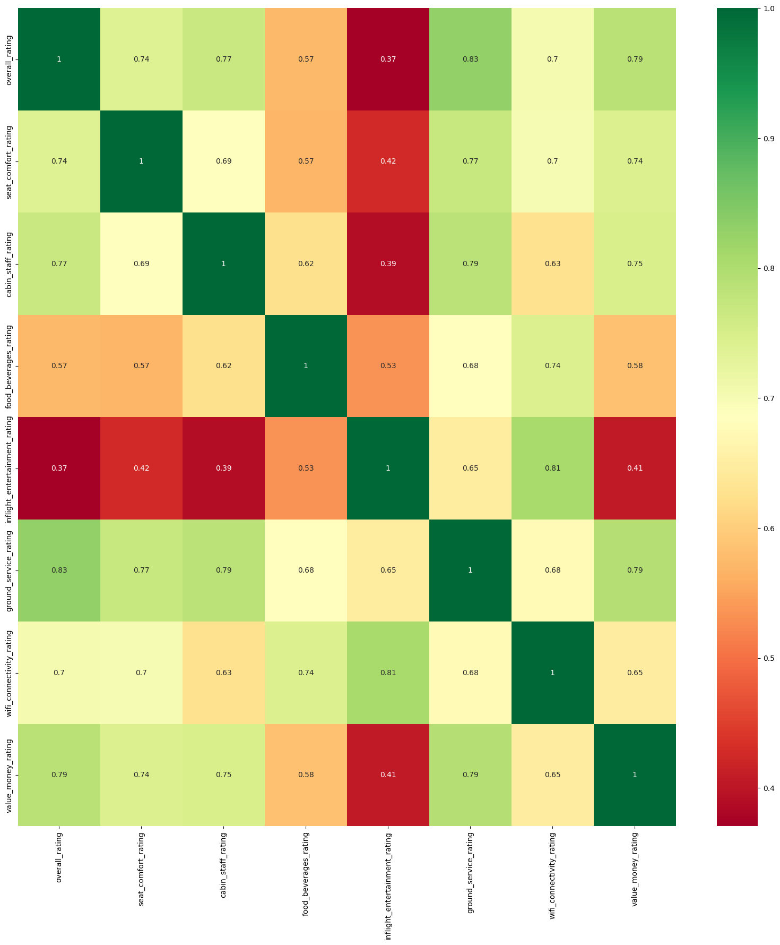

Slide 16
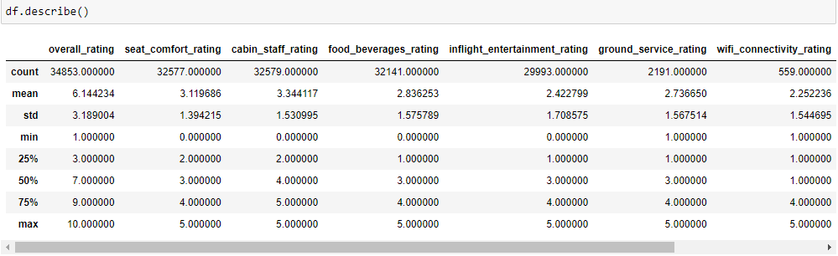
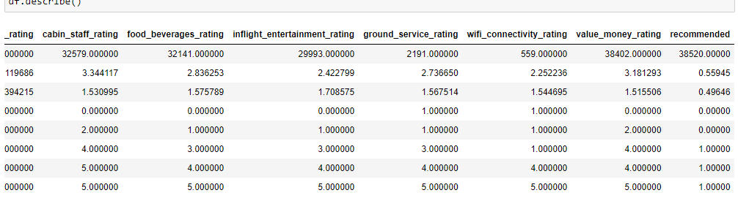

Slide 17
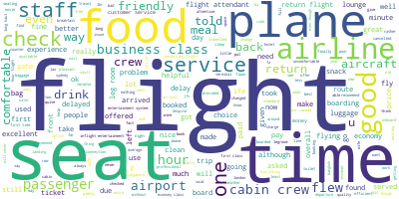
Data Word Cloud
Plot done on the most 5000 relevant words
Filght
Seat
Food
Time
Plane
Air-line
Good
Service
Airport
Check
Passenger

Slide 18
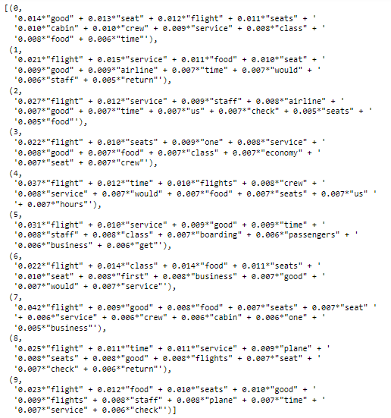
Topic Modeling LDA
Flight
Filghts
Seat
Food
Time
Plane
Air-line
staff
Service
Airport
Check
Passenger

Slide 19
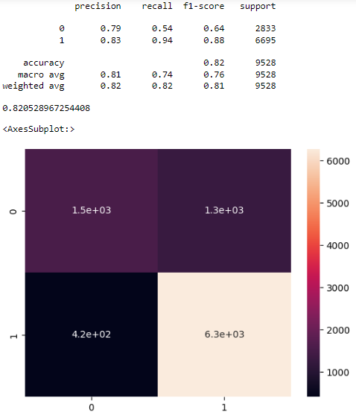
Unsupervised NLP based Model
Evaluation Metrics :
Accuracy : 82 %
Precision : 81 %
Recall : 74%
F1-Score : 76%

Slide 20
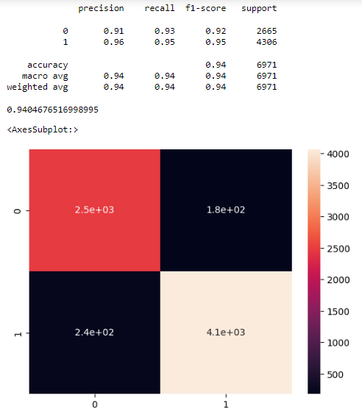
Supervised ML based Model
Evaluation Metrics :
Accuracy : 94%
Precision : 94%
Recall : 94%
F1-Score : 94%

Slide 21
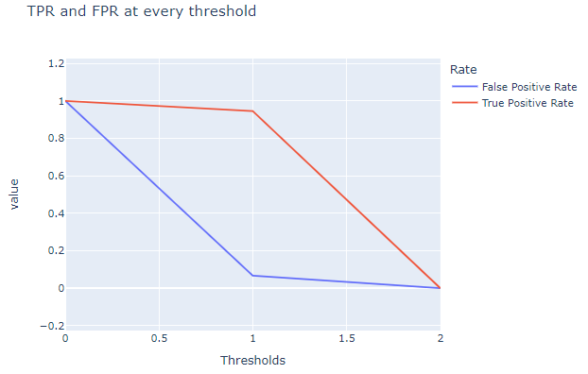
Supervised ML based Model
True Positive Rate and False Positive Rate analysis.

Slide 22
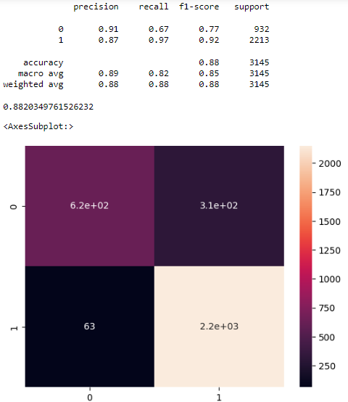
Supervised Hybrid Model
Evaluation Metrics :
Accuracy : 88%
Precision : 89%
Recall : 82%
F1-Score : 85%

Slide 23
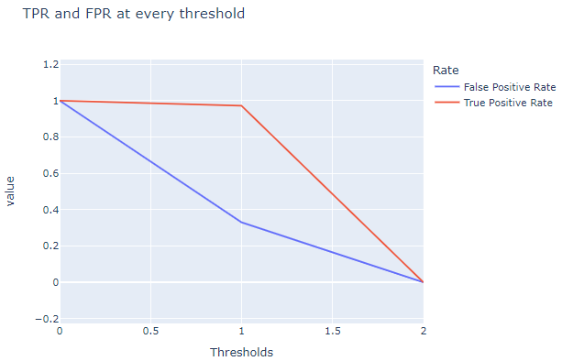
Supervised Hybrid Model
True Positive Rate and False Positive Rate analysis.

Slide 24
Conclusion

Slide 25
Thank you
Sentiment Analysis
Names : XXXXXXXX and XXXXXXXXX
Supervisor : XXXXXXXX

